Slide 1

Handling Navigation with Routes

Slide 2
Objectives
Introduction of a Router
Setup and Configuring Router
Client vs. Server Side
React Router vs. React Router DOM
Single Page Applications
Declaring routes
Handling route parameters
Using link components

Slide 3
Introduction of a Router
Almost every web application requires routing: the process of responding to a URL, based on a set of route handler declarations. In other words, this is a mapping from the URL to rendered content.
Include:
Declaring routes
Handling route parameters
Using link components

Slide 4
What is React Router?
React router is a library that allows handle routes in a web app, using dynamic routing.
Dynamic routing takes place as the app is rendering on your machine, unlike the old routing architecture where the routing is handled in a configuration outside of a running app.
React router implements a component-based approach to routing. It provides different routing components according to the needs of the application and platform.

Slide 5
Setup and Configuring Router
React Router can be installed using the npm cli utility:
npm install react-router-dom@6.16.0
import React from 'react';
import ReactDOM from 'react-dom/client';
import { BrowserRouter } from 'react-router-dom';
import App from './App';
const root = ReactDOM.createRoot(document.getElementById('root'));
root.render(
<React.StrictMode>
<BrowserRouter>
<App />
</BrowserRouter>
</React.StrictMode>
);

Slide 6
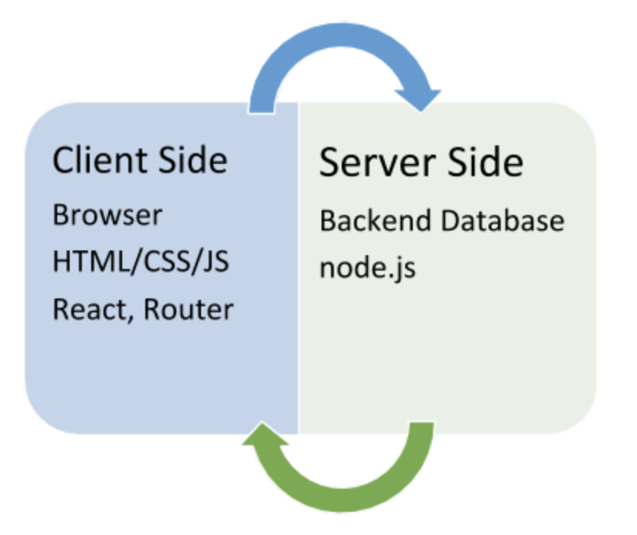
Client vs. Server Side
We can’t have a conversation about routing and React Router without mentioning client side and server side.
Client side is the browser. Its processing happens on the local machine.
Server side is where the information is processed and then sent through to a browser.

Slide 7
React Router vs. React Router DOM
React Router DOM is DOM bindings for the React Router, or in simpler terms React Router for websites. In contrast, React-Router-Native is bindings for an app development environment using React Native.
React Router come in 2 flavors, just like React:
Web
Native

Slide 8
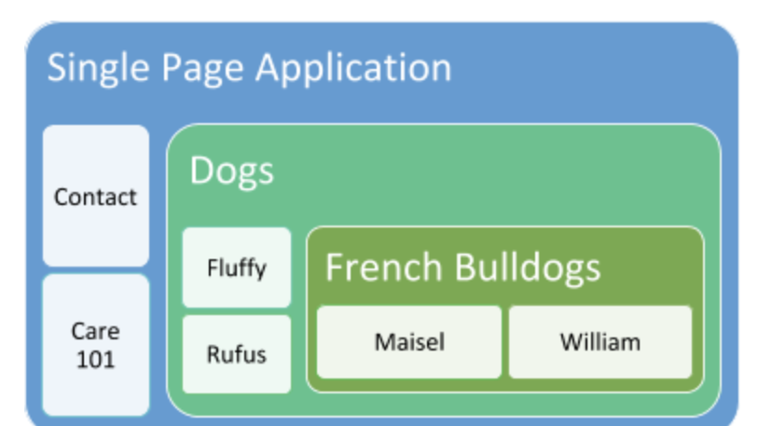

Single Page Applications
Single page applications dynamically rewrite the web page with new data from the server, instead of the default method of the browser loading entirely new pages.
When a user clicks a link, you don’t go to an entirely new page. Instead, the new context loads inline on the same page you’re already on. So only the necessary components of the page render.

Slide 9
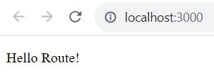
Declaring routes
With react-router, can collocate routes with the content that they render. In this section, you'll see that this is done using JSX syntax that defines routes.
Exam:
import React from 'react';
import ReactDOM from 'react-dom/client';
import {BrowserRouter as Router, Route, Routes } from 'react-router-dom';
import MyComponent from './MyComponent';
const root = ReactDOM.createRoot(document.getElementById('root'));
root.render(
<Router>
<Routes>
<Route path="/" element={<MyComponent />} />
</Routes>
</Router>
);
import * as React from "react";
function MyComponent() {
return <p>Hello Route!</p>;
}
export default MyComponent;

Slide 10
Decoupling route declarations
The difficulty with routing happens when your application has dozens of routes declared within a single module since it's more difficult to mentally map routes to features.
To help with this, each top-level feature of the application can define its own routes. This way, it's clear which routes belong to which feature.

Slide 11
Decoupling route declarations – cont’d
BrowserRouter provides routing features to the application using the HTML5 History API.
Route is used to define a route in the application.
Routes is used to wrap Route components and define the routes of the application.
<Route index element={<Redirect path="/one" />} /> defines a child route within the main route
import React from 'react';
import ReactDOM from 'react-dom/client';
import { BrowserRouter as Router, Route, Routes } from 'react-router-dom';
import Layout from './Layout';
import Redirect from './Redirect';
import oneRoutes from "./one";
import twoRoutes from "./two";
const root = ReactDOM.createRoot(document.getElementById('root'));
root.render(
<Router>
<Routes>
<Route path="/" element={<Layout />}>
<Route index element={<Redirect path="/one" />} />
{oneRoutes}
{twoRoutes}
</Route>
</Routes>
</Router>
);

Slide 12
Decoupling route declarations – cont’d
import * as React from "react";
import { Outlet } from "react-router-dom";
function Layout() {
return (
<main>
<Outlet />
</main>
);
}
export default Layout;
The Outlet component is used to display the content of child routes.
The Redirect function component is used the useNavigate hook to retrieve the navigate object to perform the redirection.
In the useEffect hook, register an effect function that will be executed when the Redirect component is attached to the DOM tree. Inside the effect function, we call navigate(props.path) to perform the redirection to the path passed in through props.
import * as React from "react";
import { useNavigate } from "react-router-dom";
function Redirect(props) {
const navigate = useNavigate();
React.useEffect(() => {
navigate(props.path);
}, []);
}
export default Redirect;

Slide 13
Exercise 20: Demo about Decoupling route declarations

Slide 14
Handling route parameters
Most applications will use both static and dynamic routes
Handling route parameters:
Resource IDs in routes
Optional parameters

Slide 15
Resource IDs in routes
This code to get the ID and then make an API call that fetches the relevant resource data.
This will require a route that includes the user ID, which then needs to somehow be passed to the component so that it can fetch the user.
The : syntax marks the beginning of a URL variable. The id variable will be passed to the UserContainer component
import React from "react";
import { BrowserRouter as Router, Routes, Route } from "react-router-dom";
import UsersContainer from "./UsersContainer";
import UserContainer from "./UserContainer";
function App() {
return (
<Router>
<Routes>
<Route path="/" element={<UsersContainer />} />
<Route path="/users/:id" element={<UserContainer />} />
</Routes>
</Router>
);
}
export default App;

Slide 16
Exercise 21: Demo about Resource IDs in routes

Slide 17
Optional parameters
Sometimes, we need optional URL path values and query parameters. URLs work best for simple options, and query parameters work best if there are many values that the component can use.
import React from "react";
import { BrowserRouter as Router, Routes, Route } from "react-router-dom";
import UsersContainer from "./UsersContainer";
function App() {
return (
<Router>
<Routes>
<Route path="/users">
<Route path=":desc" element={<UsersContainer />} />
<Route path="" element={<UsersContainer />} />
</Route>
</Routes>
</Router>
);
}
export default App;

Slide 18
Using link components
To use the standard <a> elements to link to pages controlled by react-router. The problem with this approach is that these links will try to locate the page on the backend by sending a GET request.
How <Link> elements are just like <a> elements in most ways.

Slide 19
Exercise 22: Demo about Optional parameters and Link

Slide 20
Lab 5: Demo about React Router

Slide 21
Summary
Concepts were introduced:
Introduction of a Router
Setup and Configuring Router
Client vs. Server Side
React Router vs. React Router DOM
Single Page Applications
Declaring routes
Handling route parameters
Using link components
Reference: https://blog.webdevsimplified.com/2022-07/react-router/

